Slide 1

Best practices validation with dbatools
PowerShell and SQL Server together

Slide 2




Our Incredible Sponsors:

Slide 3

SQLSat Lisbon is brought you by:

Slide 4

Tuga IT 2017 (18-20 May, 2017)
http://www.tugait.pt/2017

Slide 5
Say Thank you to Volunteers:
They spend their FREE time to give you this event.
Because they are crazy. ☺
Because they want YOU to learn from the BEST IN THE WORLD.

Slide 6

André Batista (The Guilty One):

Slide 7
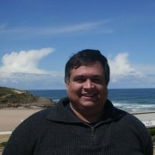
Paulo Matos (Finances):

Slide 8
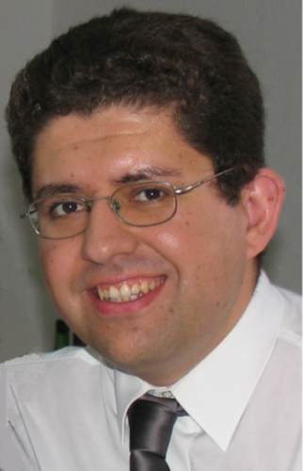
Pedro Simões (Sponsors):

Slide 9

Claudio Silva (Special Projects):

Slide 10
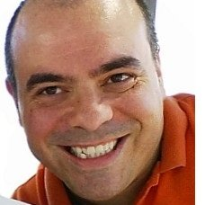
Paulo Borges (Operations):

Slide 11
3 Sponsor Sessions at 15:20
Don’t miss them, they might be getting distributing some awesome prizes!
Rumos
Profisee
CozyRoc

Slide 12
Important Activities:
WIT – Women in Technology
10:15 at .NET Room (Azure & Infrastructure Track)
Data Science Booth (near the sponsors)

Slide 13







Who am I?
MS SQL Server
DBA | Data architect
Working with MS SQL Server since version 2000
PowerShell MVP
Major contributor on open source projects
dbatools (http://dbatools.io)
dbareports (http://dbareports.io)
Friend of redgate
@claudioessilva
claudioessilva
claudiosil100@gmail.com
redglue.eu/blog
13 |

Slide 14
Agenda
dbatools - What is and who runs it?
Install is easy
Best practices – Demos
What’s next?
Questions
14 |

Slide 15
dbatools - What is and who runs it?
Open-source PowerShell module
Developed and maintained by SQL Server and PowerShell community members
The team is made up of more than 30 contributors
MVPs (PowerShell & Data Platform)
DBAs (from all kind of business areas)
Developers
15 |
Notes:
Show sites:
http://dbatools.io
http://dbatools.io/team
http://dbatools.io/git

Slide 16
Install is easy
PowerShell Gallery (v5.0+)
Install-Module dbatools
GitHub – dbatools.io/git
Clone repo found at dbatools.io/git, Import-Module dbatools
Invoke-Expression (Invoke-WebRequest https://git.io/vn1hQ)
16 |

Slide 17
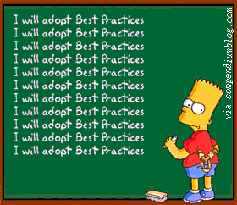
Best practices - Demo
17 |

Slide 18
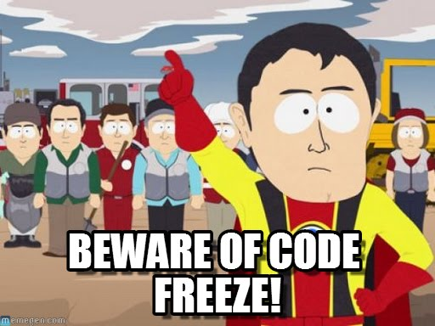
What’s next?
Code freeze (since 1th march – no new commands)
We will be fixing all open issues and release updates often
It will be standardized and as stable as possible
Then release v1.0
After code freeze
Automated tests (using pester)
More documentation
More commands
More contributors
Source: http://www.memegen.com/meme/6fvulz
18 |

Slide 19
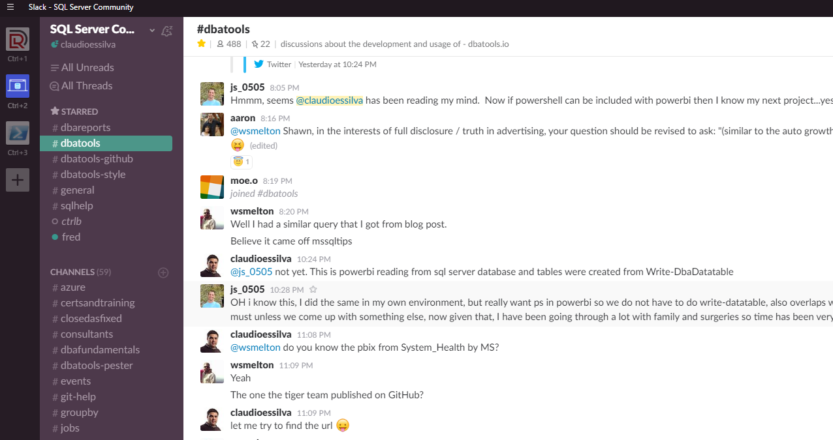
Join us! - dbatools.io/slack
19 |
Notes:
dbatools.io/slack

Slide 20
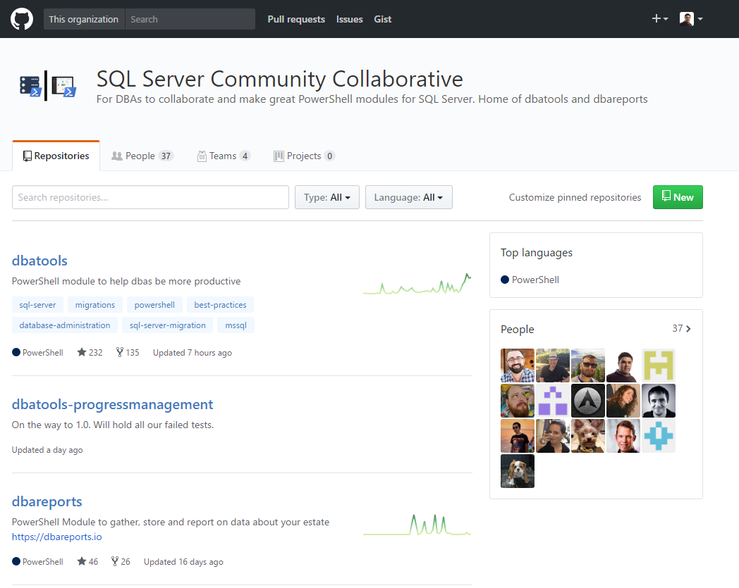
Join us! - dbatools.io/git
20 |
Notes:
dbatools.io/git

Slide 21

Questions?
21 |

Slide 22

For your attending today,
Source: www.lolsheaven.com
22 |

